Slide 1
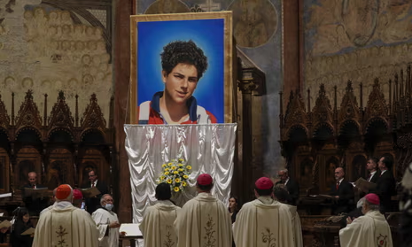

Saint Carlo Acutis
The first millennial saint!
K: Know about the life of Saint Carlo Acutis and his significance
S: Interpretation of artwork, symbolism or religious belief

Slide 2
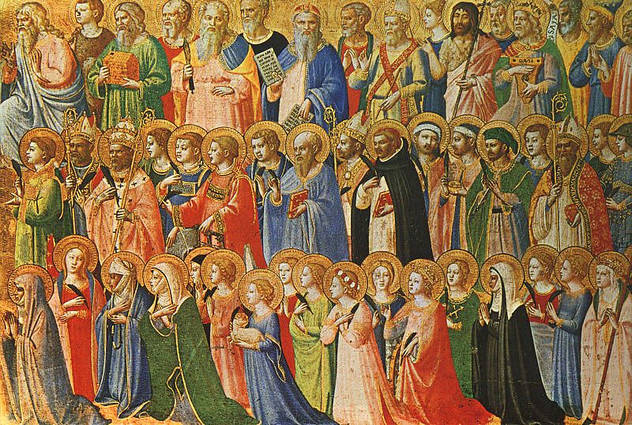
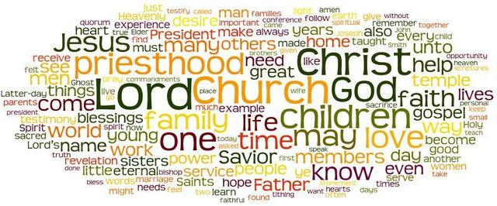
Think-Pair-Share
What do you think of when you think of a Saint?

Slide 3

What if I told you....
There is a Saint who:
Used computers, created a website
Played computer games
Played Pokemon?
Lived in the 1990s and early 2000s
Loved football
Had pets
Was holy
Was an ‘ordinary’ young person- aged 15
Was recently made a Saint (7th Sept)

Slide 4
Introductory Video
Mind-map ideas as you watch the video
K: Know about the life of Saint Carlo Acutis and his significance
Saint Carlo Acutis
Challenge: What can Catholics learn from the example of St. Carlo? How can you learn from his example?
https://youtu.be/PLFusUobkJ4?t=248

Slide 5
Notable points from the video:
K: Know about the life of Saint Carlo Acutis and his significance
Built a website to evangelise
Devotion to the Eucharist and rosary
Born- London 1991
Contracted Leukemia- “I offer all my suffering for the world, Pope and Church”
“Sun- suntan, Eucharist- we become saints”
Saint Carlo Acutis
Grew up in Milan
Preach to his friends
He secretly helped the poor and needy in Milan
His faith was infectious to friends and family
Challenge Feedback: What can Catholics learn from the example of St. Carlo? How can you learn from his example?

Slide 6
Documentary option- answer the questions
K: Know about the life of Blessed Carlo Acutis and his significance
Where did St. Carlo grow up?
How was Carlo described by his parents?
What did Carlo create?
What did Carlo say about the Eucharist?
How did Carlo’s faith influence is mother?
What are the Eucharistic miracles of the world?
What belief does it emphasise?
What is evangelisation? How did Carlo use the Internet?
Where was his Beatification? (Challenge: Who else lived in Assisi?)
Describe St. Carlo’s shrine in Assisi. How are they preparing for his sainthood? How did St. Carlo inspire others?
What was his miracle that led to Beatification?
How will St. Carlo’s sainthood inspire young people?
https://youtu.be/YUOgYiw_OZ0

Slide 7
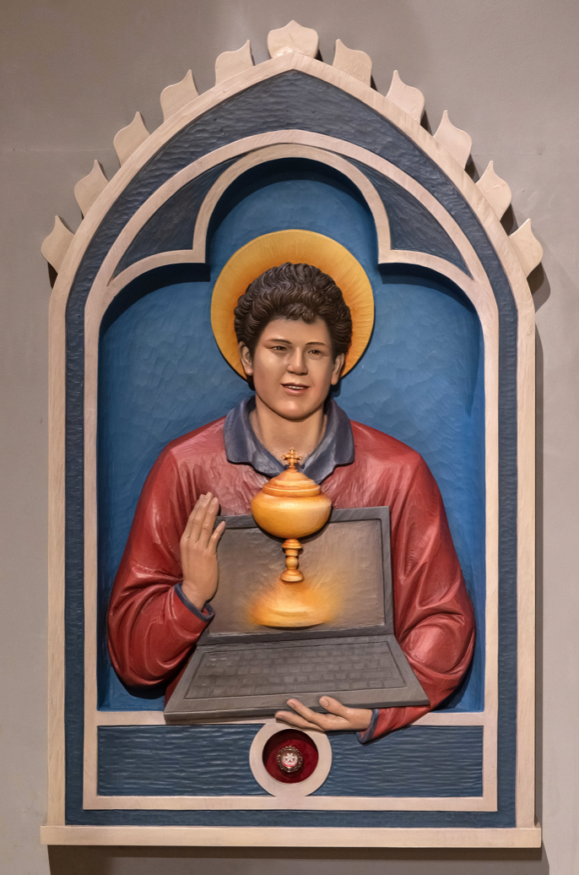
TPS: What does this image tell you about St Carlo?
S: Interpretation of artwork, symbolism or religious belief
What does the halo mean?
Why is he smiling? (What does that tell you about his suffering of his illness)?
How old do you think he was?
How is he dressed?
What items is he holding?
Why do you think he is holding these?
Challenge: How can we be ‘digital apostles’?

Slide 8
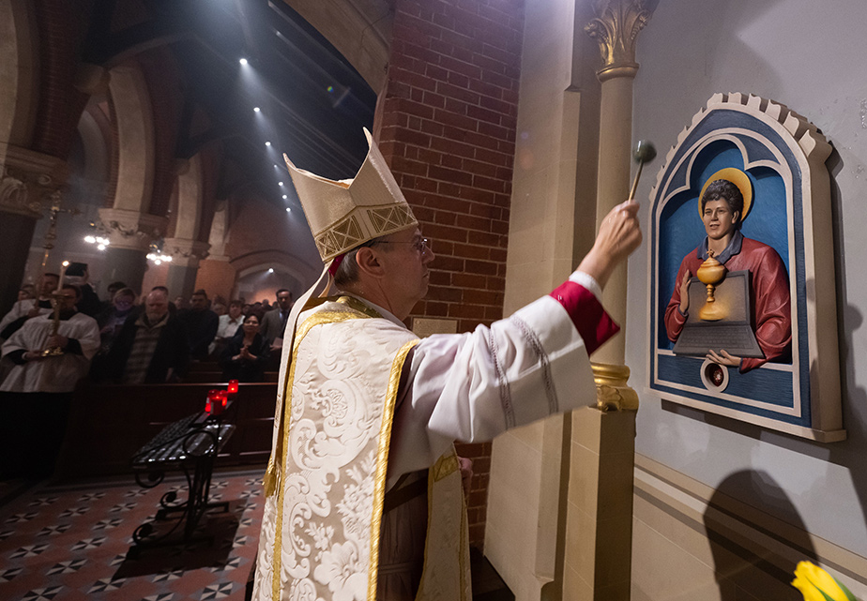
S: Interpretation of artwork, symbolism or religious belief
This is a shrine to Saint Carlo Acutis in the well-known Catholic Corpus Christi Church in Covent Garden, London.
Why London?
The shrine contains a relic. Here it is being blessed and unveiled by a Bishop.
Notes:
It’s where he was born

Slide 9
Annotate the image: What does this image tell you about St Carlo?
S: Interpretation of artwork, symbolism or religious belief
This is a shrine to St. Carlo Acutis in the well-known Catholic Corpus Christi Church in Covent Garden. The shrine contains a relic.

Slide 10
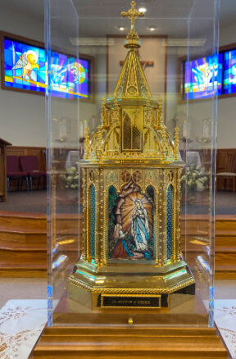
Create an icon/image/shrine to one of the saints you have studied.
S: Interpretation of artwork, symbolism or religious belief
Success criteria:
Be about Ss. Andrew, George, Patrick, David; St John Henry Newman; Mother Teresa; St. Carlo; Oscar Romero or St Thomas More.
Include specific symbols to show what the saint did in their life
Include symbols to show sainthood and an image of the Saint
Justify the symbolism of the image, how will it help believers?

Slide 11
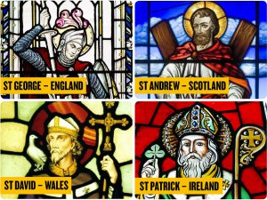
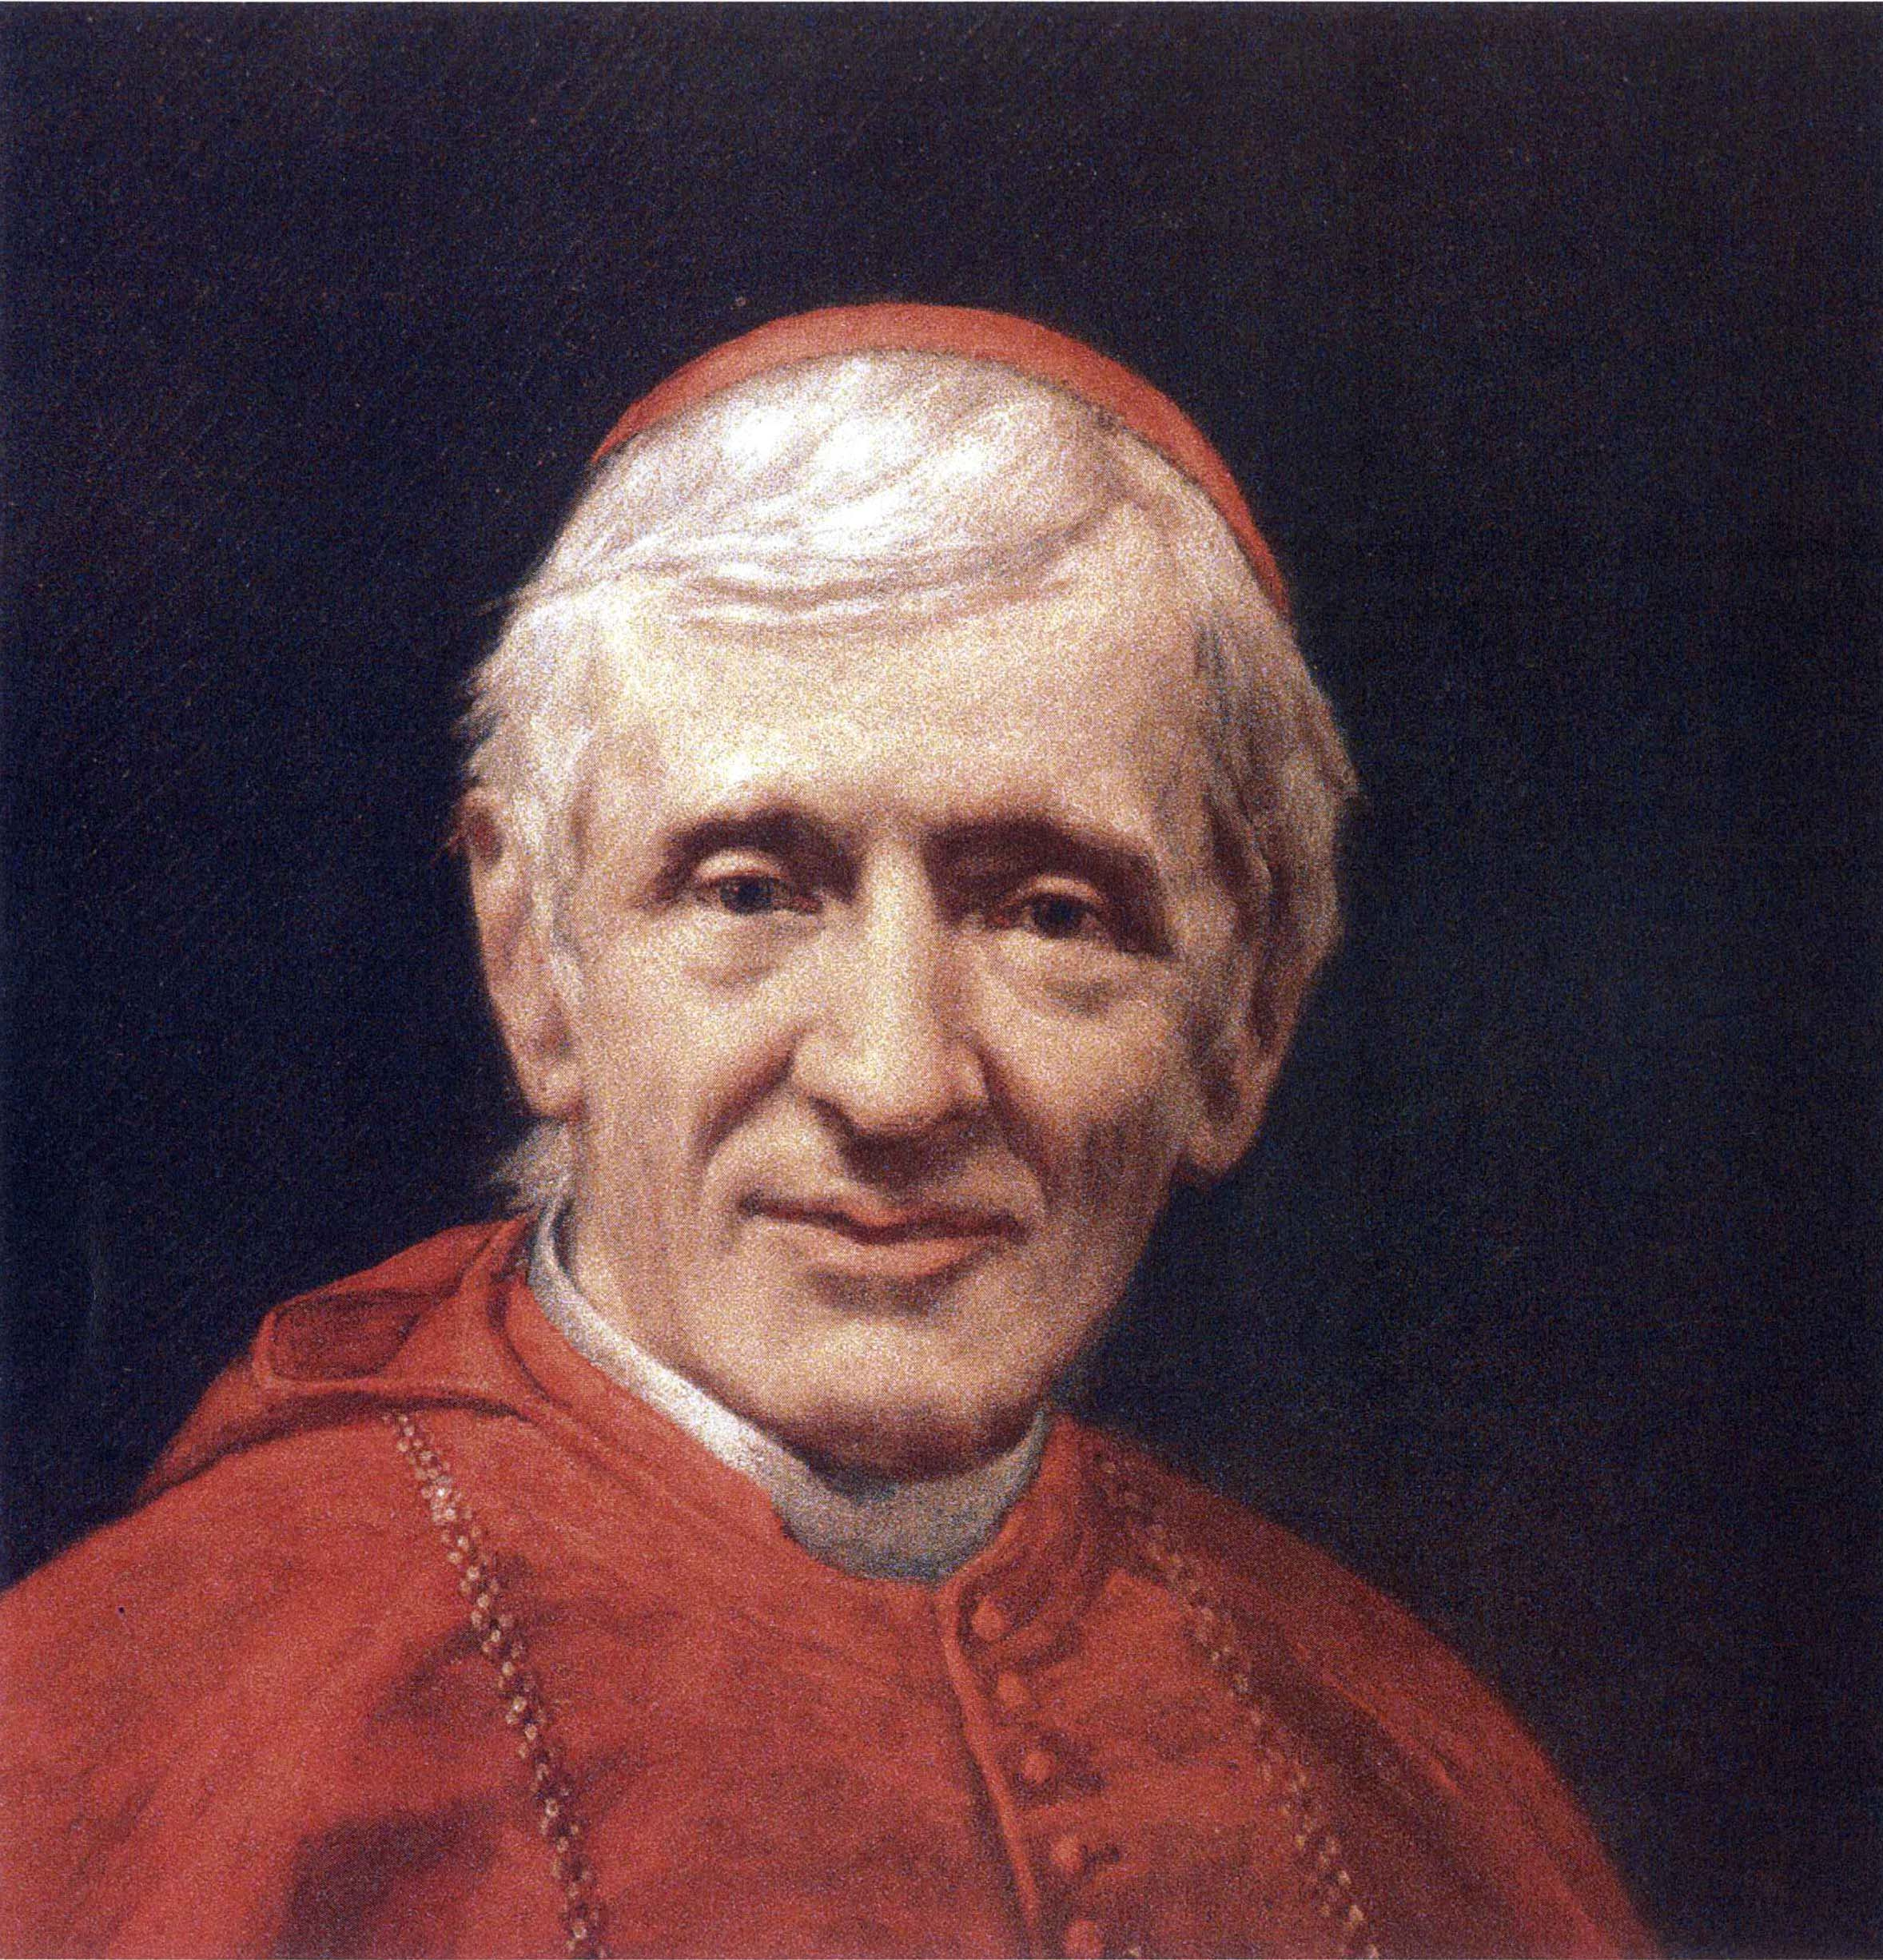
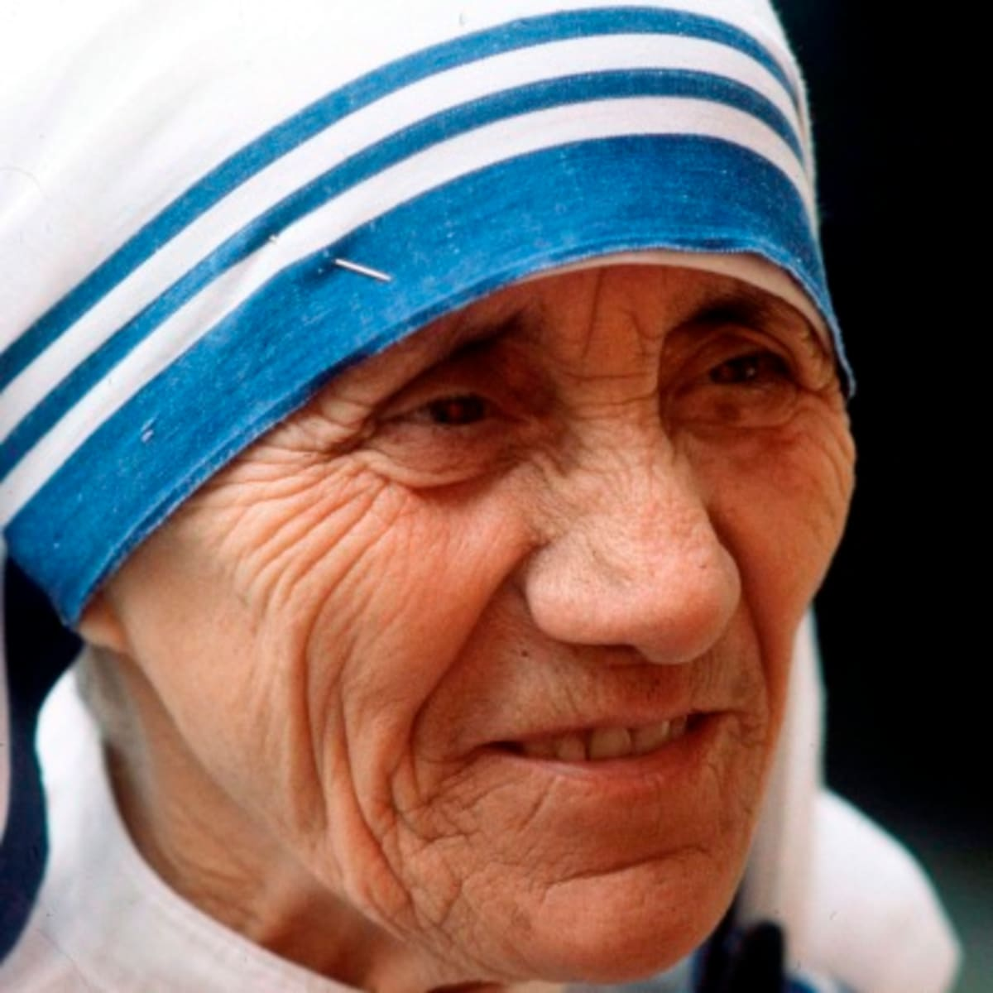
Create an icon/image/shrine to one of the saints you have studied.
S: Interpretation of artwork, symbolism or religious belief
Success criteria:
Be about Ss. Andrew, George, Patrick, David; St John Henry Newman; Mother Teresa; St. Carlo; Oscar Romero or St Thomas More.
Include specific symbols to show what the saint did in their life
Include symbols to show sainthood and an image of the Saint
Justify the symbolism of the image, how will it help believers?

Slide 12
Create an icon/image/shrine to one of the saints you have studied.
S: Interpretation of artwork, symbolism or religious belief
My image of saint__________ will help the faithful, because I have included ______________ this symbolises/shows that the saint did_________.
I have picked this saint because.....

Slide 13
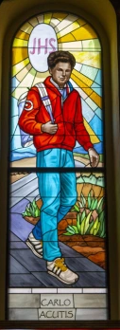
What does this prayer suggest?
We need saints attributed to Pope John Paul II
We need saints without veil or cassock. We need saints who wear jeans and sneakers.
We need saints who go to the movies, listen to music and hang out with friends.
We need saints who put God in first place, but who let go of their power.
We need saints who have time everyday to pray and who know how to date in purity and chastity, or who consecrate their chastity.
We need modern saints, Saints of the 21st century with a spirituality that is part of our time.
We need saints committed to the poor and the necessary social changes.
We need saints who live in the world and who are sanctified in the world, who are not afraid to live in the world.
We need saints who drink Coke and eat hot dogs, who wear jeans, who are Internet-savvy, who listen to CDs.
We need saints who passionately love the Eucharist and who are not ashamed to drink a soda or eat pizza on weekends with friends.
We need saints who like movies, the theater, music, dance, sports.
We need saints who are social, open, normal, friendly, happy and who are good companions.
We need saints who are in the world and know how to taste the pure and nice things of the world but who aren’t of the world.

Slide 14

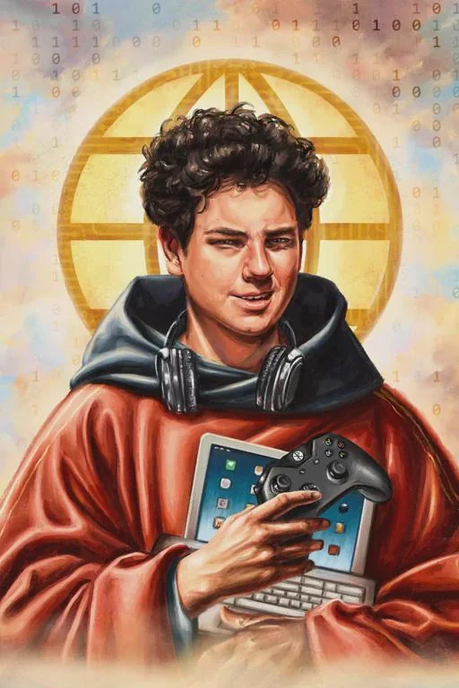
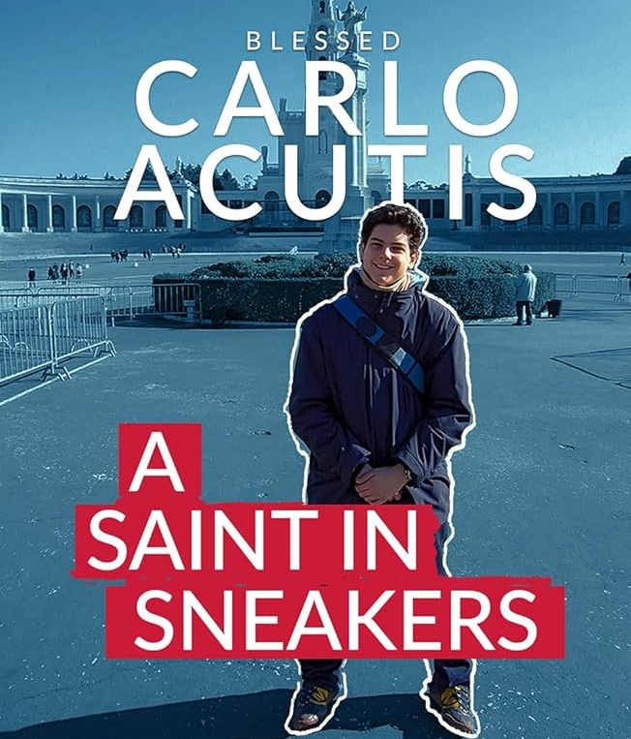
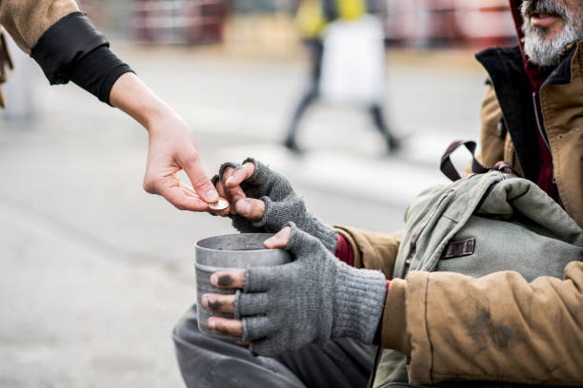

How can you be like Carlo Acutis?

Slide 15
Homework
Visit the Eucharistic Miracles website that Bl. Carlo Acutis created
http://www.miracolieucaristici.org/en/Liste/list.html
http://www.miracolieucaristici.org/en/Liste/biografia.html
Write 5 bullet points about one Eucharistic miracle
Write 5 bullet points about Bl. Carlo Acutis
Challenge: Why do you think Bl. Carlo Acutis used the Internet to evangelise? Evangelise- spread the Word of God.

Slide 16
Annotate the image: What does this image tell you about Bl. Carlo?
This is a shrine to St. Carlo Acutis in the well-known Catholic Corpus Christi Church in Covent Garden. The shrine contains a relic.

